Slide 1
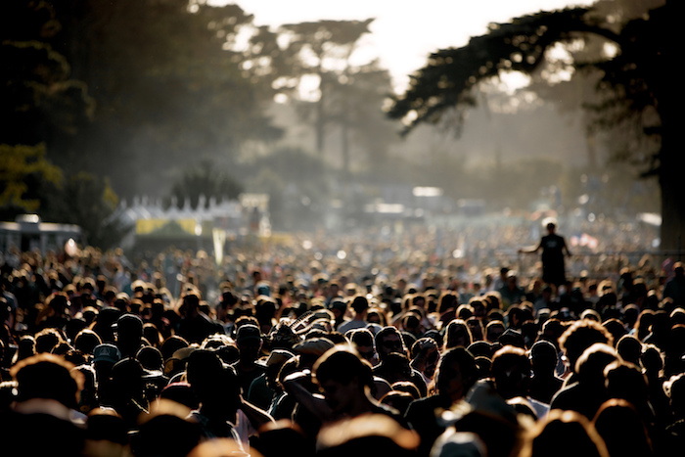


Dealing With Data - Final Project
feat.
Nirmal Kagolanu, Anthony Mcleod, Nate Bromberg, David Kallman, Ted Watson

Slide 2

Agenda
Data Gathering Stuff
Summary Stuff
Hot Stuff
Lyrical Stuff
Genre Stuff
Song Metric Stuff
Throwback Stuff
Notes:
Opening Slide – joke about our second project on Spotify
Agenda:
1.ER Diagram
2.Data Gathering
3.Summary Statistics
1.Top Tracks
2.Top Artists
3.Top by decade
4.Lyrics Visualization
5.Evolution of Genres
6.Song structure by genre
7.Evolution of song length

Slide 3



Data Gathering
Get Track Metrics, Album and Artist Features
Save transformed CSV
RecSys Challenge
WEB API
(Million Playlist Data Set)
Download JSON files
Connect to DropBox API
Connect to Spotify API
Notes:
lyricwikia API
Opening Slide – joke about our second project on Spotify
Agenda:
1.ER Diagram
2.Data Gathering
3.Summary Statistics
1.Top Tracks
2.Top Artists
3.Top by decade
4.Lyrics Visualization
5.Evolution of Genres
6.Song structure by genre
7.Evolution of song length

Slide 4
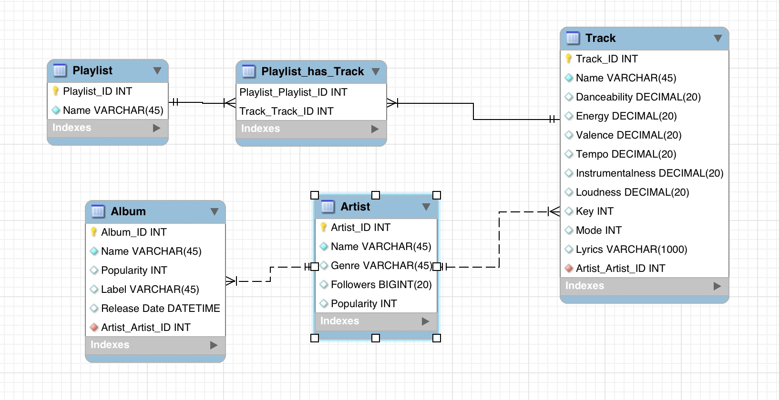
ER Diagram
Notes:
Opening Slide – joke about our second project on Spotify
Agenda:
1.ER Diagram
2.Data Gathering
3.Summary Statistics
1.Top Tracks
2.Top Artists
3.Top by decade
4.Lyrics Visualization
5.Evolution of Genres
6.Song structure by genre
7.Evolution of song length

Slide 5




Summary Statistics
After filtering by tracks that are in less than 5 playlists
98,000
Playlists
674,702
Tracks
269,034
Albums
109,116
Artists
97,539
Playlists
111,469
Tracks
50,956
Albums
20,089
Artists
674,702 111,469 Tracks
Notes:
Opening Slide – joke about our second project on Spotify
Agenda:
1.ER Diagram
2.Data Gathering
3.Summary Statistics
1.Top Tracks
2.Top Artists
3.Top by decade
4.Lyrics Visualization
5.Evolution of Genres
6.Song structure by genre
7.Evolution of song length

Slide 6
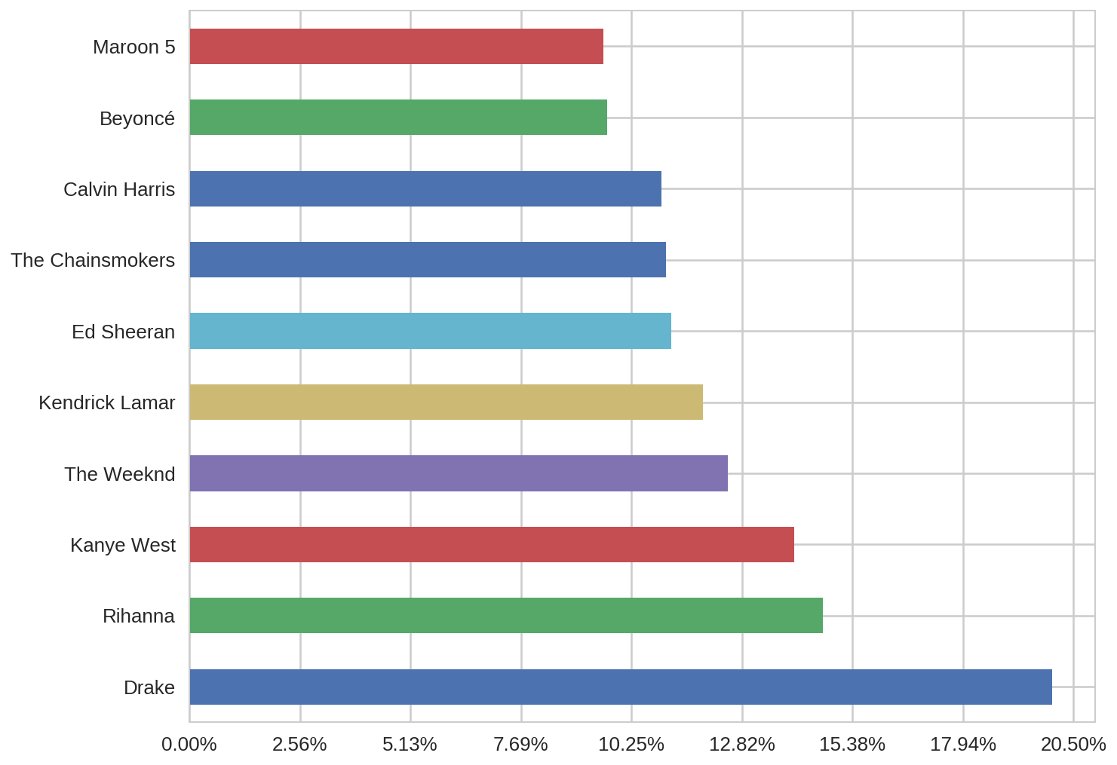
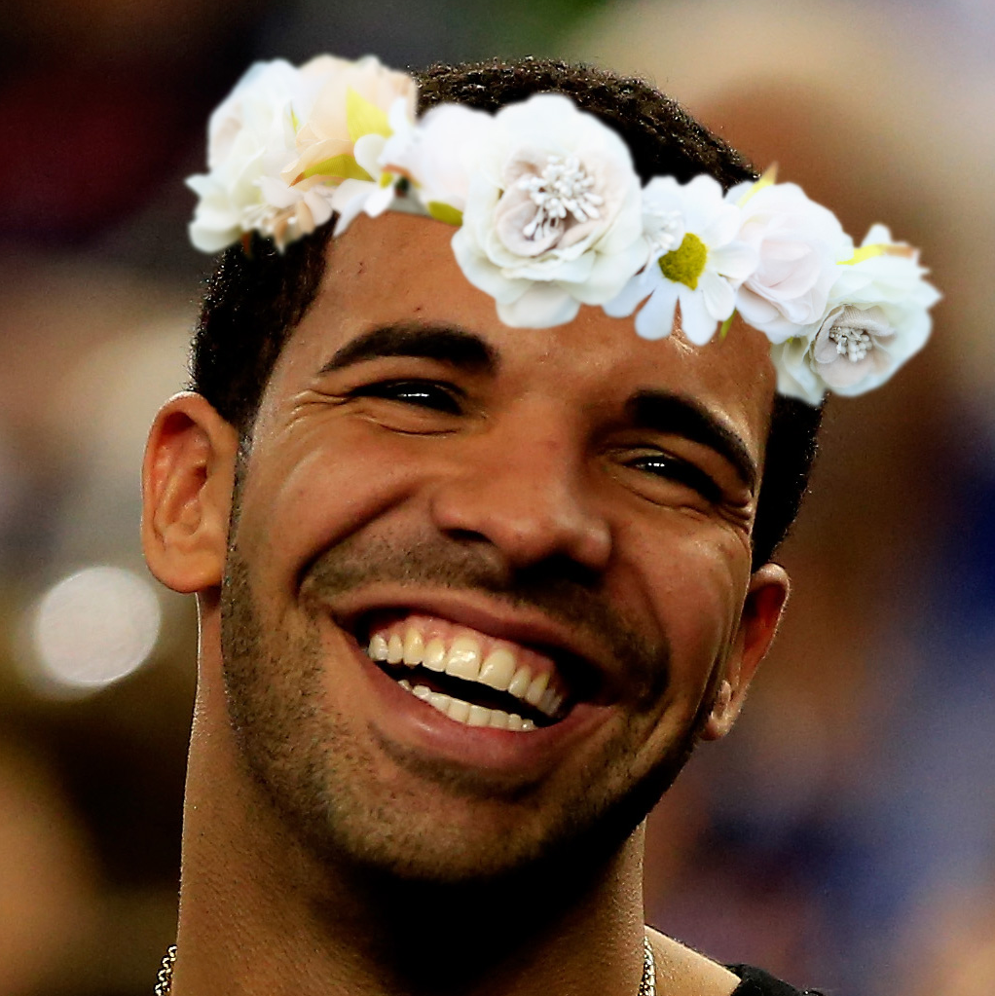
Top Artists
Notes:
Opening Slide – joke about our second project on Spotify
Agenda:
1.ER Diagram
2.Data Gathering
3.Summary Statistics
1.Top Tracks
2.Top Artists
3.Top by decade
4.Lyrics Visualization
5.Evolution of Genres
6.Song structure by genre
7.Evolution of song length

Slide 7
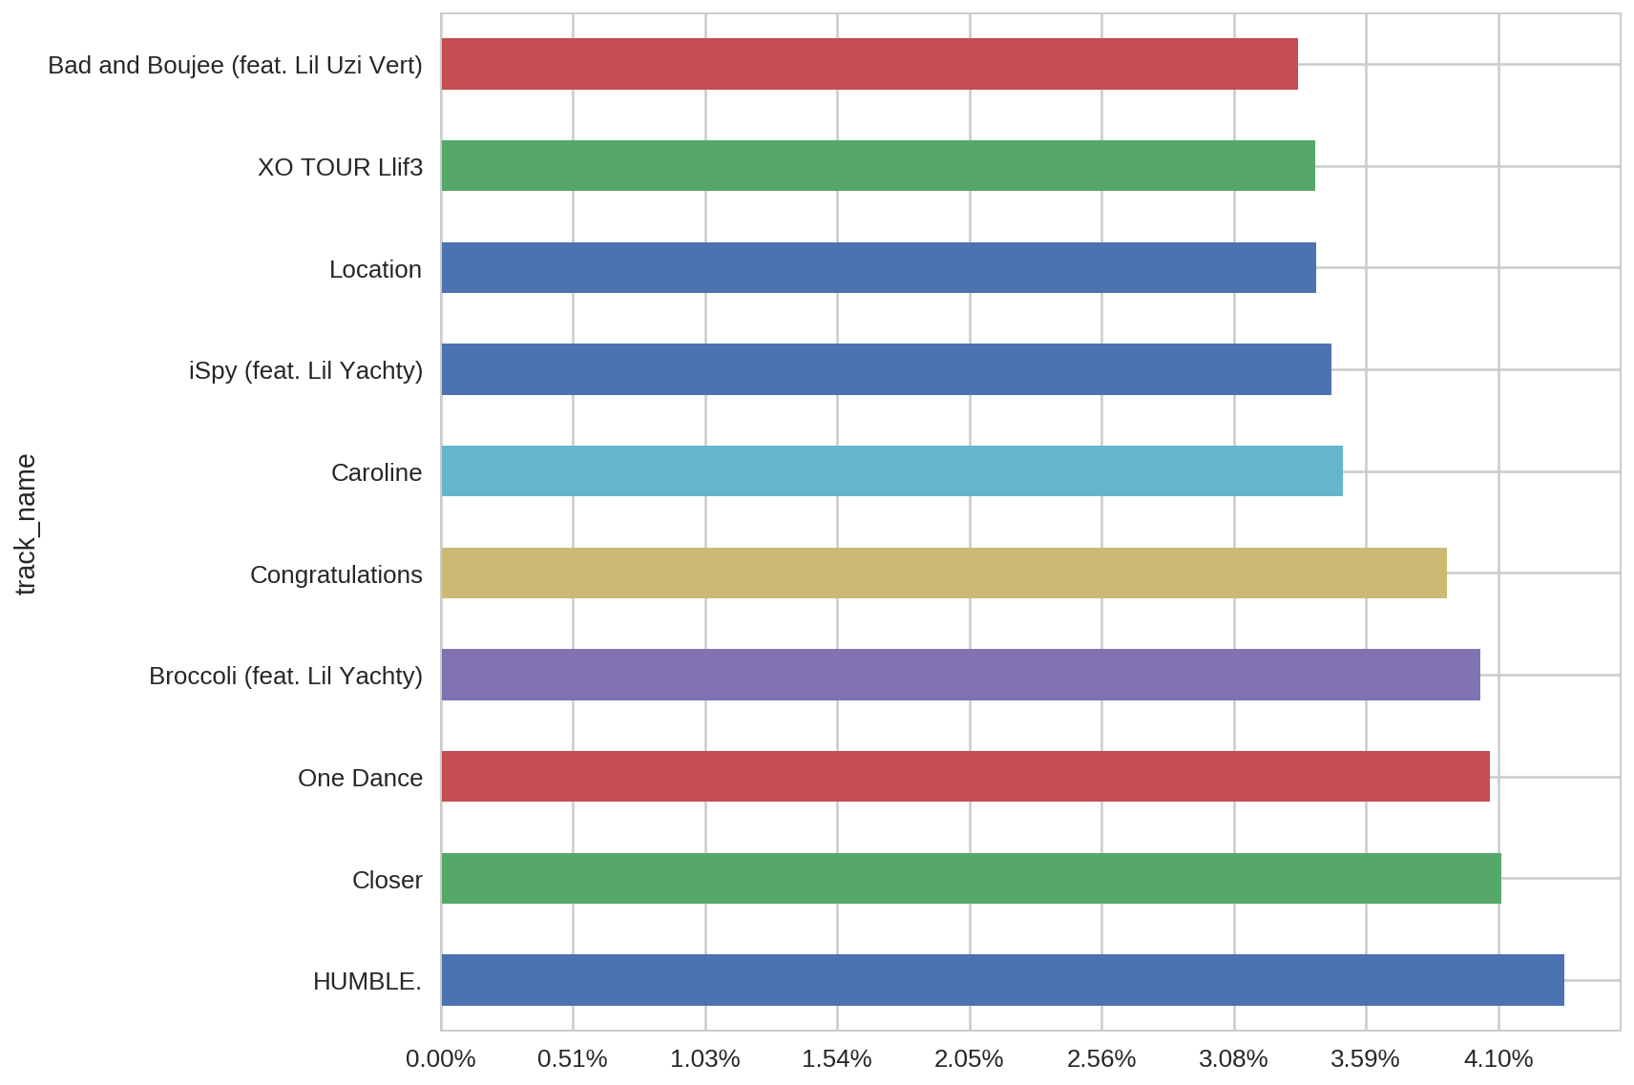
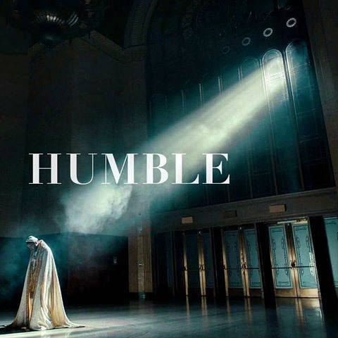
Top Tracks
Notes:
Opening Slide – joke about our second project on Spotify
Agenda:
1.ER Diagram
2.Data Gathering
3.Summary Statistics
1.Top Tracks
2.Top Artists
3.Top by decade
4.Lyrics Visualization
5.Evolution of Genres
6.Song structure by genre
7.Evolution of song length

Slide 8
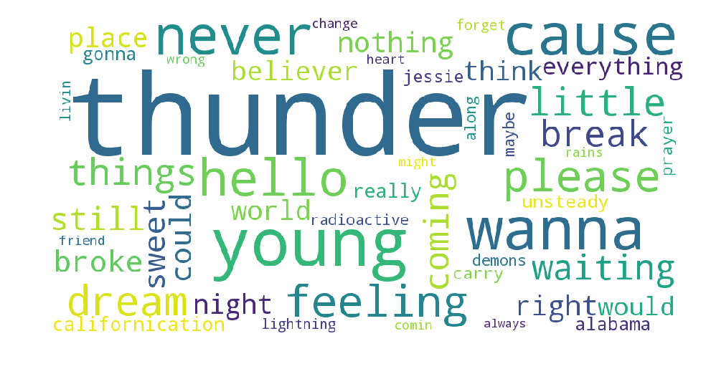
Most Common Words in Rock
Notes:
We took the top 50 tracks from each genre and made Word Clouds of the top 50 words in each genre.
Removed words less than 5 letters to remove pronouns, prepositions, and some obvious 4-letter expletives.
We didn’t take into account the frequency of each word in a song
Thunder which says Thunder 51 times…
Never, wanna, cause: are all higher ranking words shared between each genre >> conclude that grammar isn’t popular anymore.

Slide 9
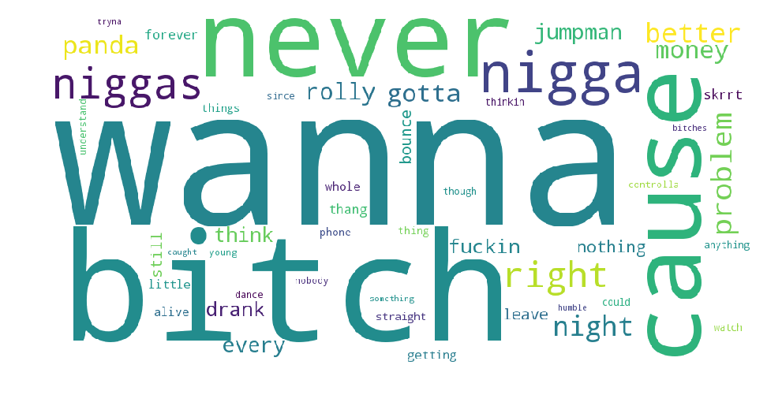

Most Common Words in Hip-Hop
Notes:
Then did some additional filtering for... other reason.
We see the same

Slide 10
Most Common Words in Hip-Hop

Slide 11
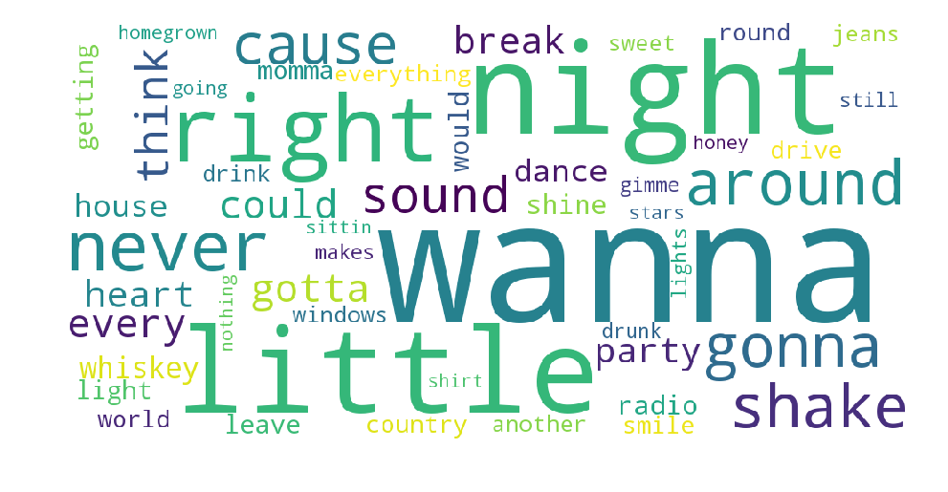
Most Common Words in Country
Notes:
Similarly with country music, we see a number of stereotypical “country” words: country, whiskey, drink, drunk, jeans

Slide 12
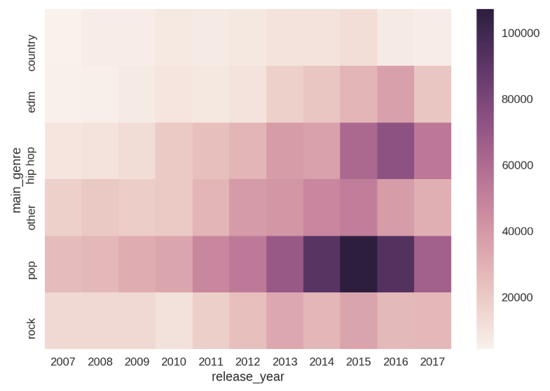
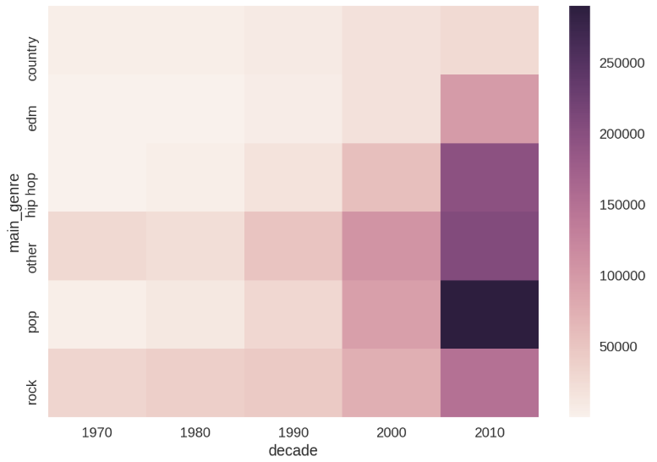
Evolution of Genre Popularity
Notes:
Opening Slide – joke about our second project on Spotify
Agenda:
1.ER Diagram
2.Data Gathering
3.Summary Statistics
1.Top Tracks
2.Top Artists
3.Top by decade
4.Lyrics Visualization
5.Evolution of Genres
6.Song structure by genre
7.Evolution of song length

Slide 13
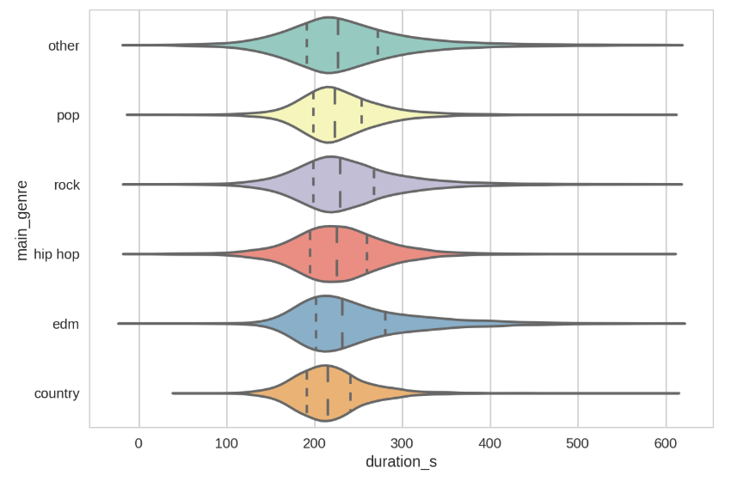
Song Length by Genre
Notes:
EDM - many popular EDM tracks have an “Extended Mix” for DJs to play at club which are longer and easier to mix

Slide 14
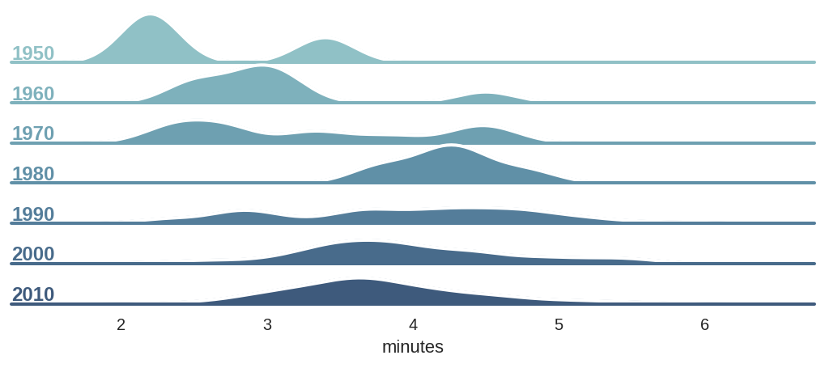
Average Song Length Over Time
http://ajournalofmusicalthings.com/good-question-songs-radio-length/
Notes:
Back then 45 rpm hold up to 7 minutes of music. Mean is 3:20 in length
With CDs, no restricted by the medium. Can put more or fewer songs.
But averaging around 3 and half minutes because they fit into radio nicely.

Slide 15
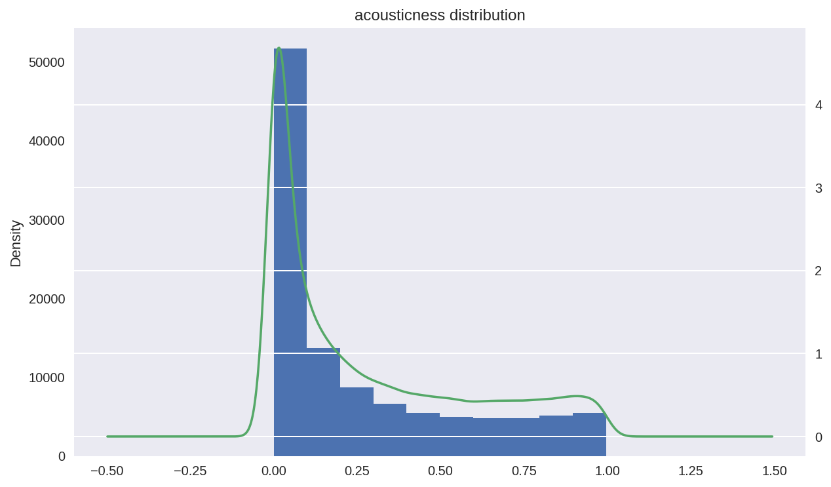
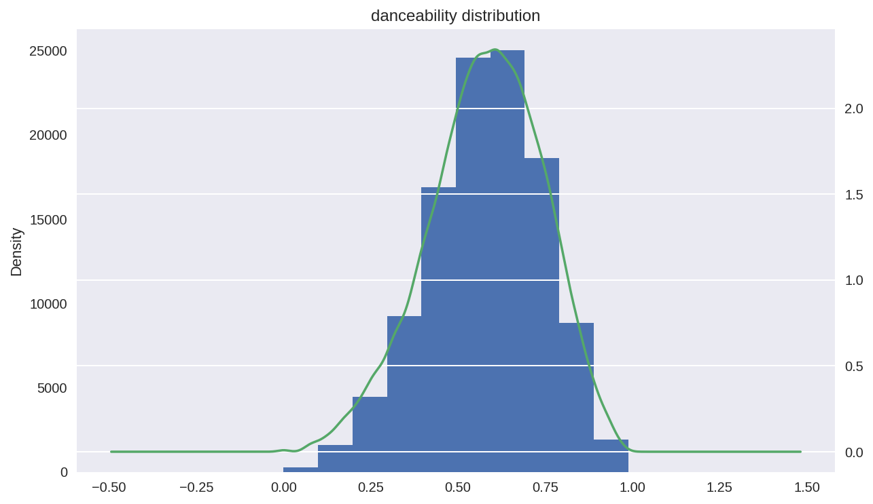
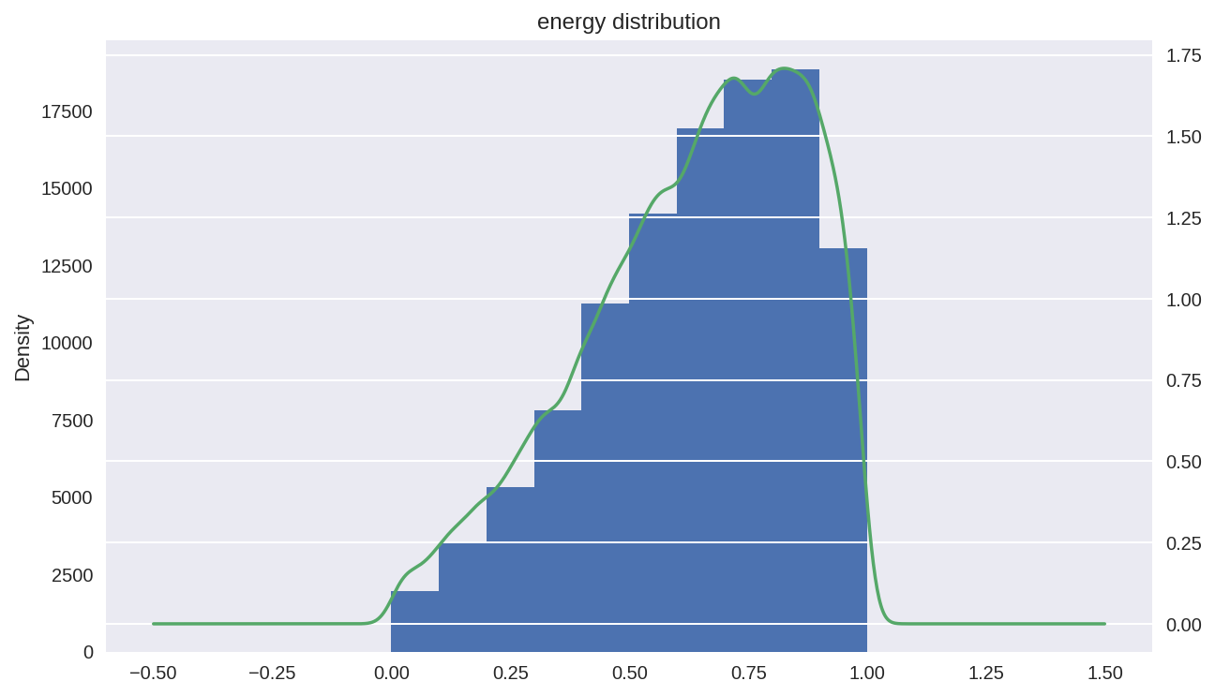
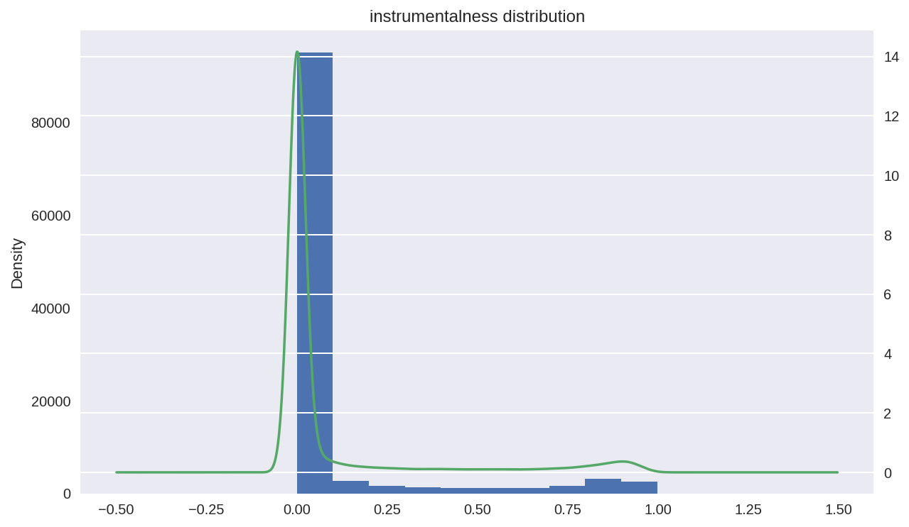
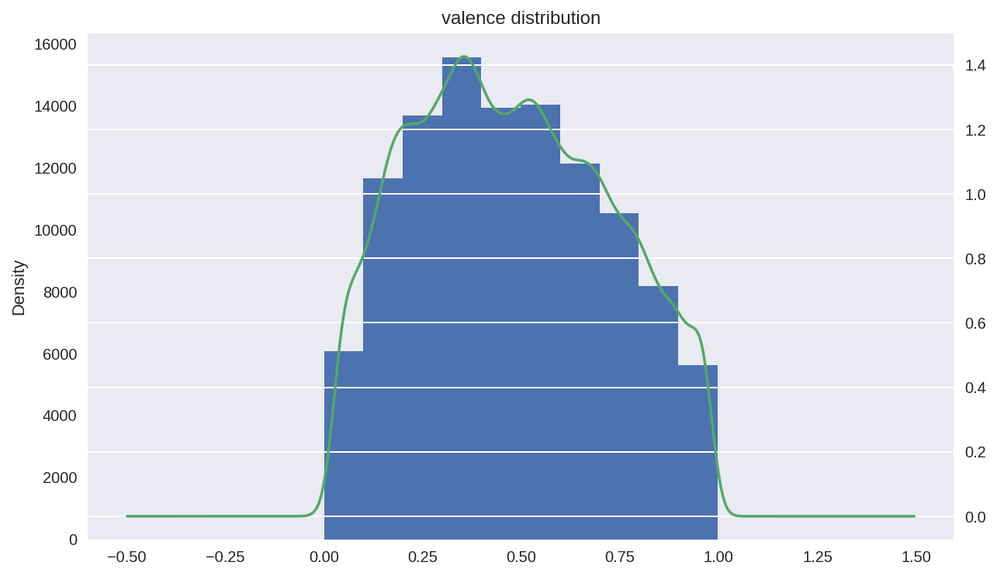
Breakdown of Song Attributes
Danceability
Energy
Acousticness
Valence
Instrumentalness

Slide 16
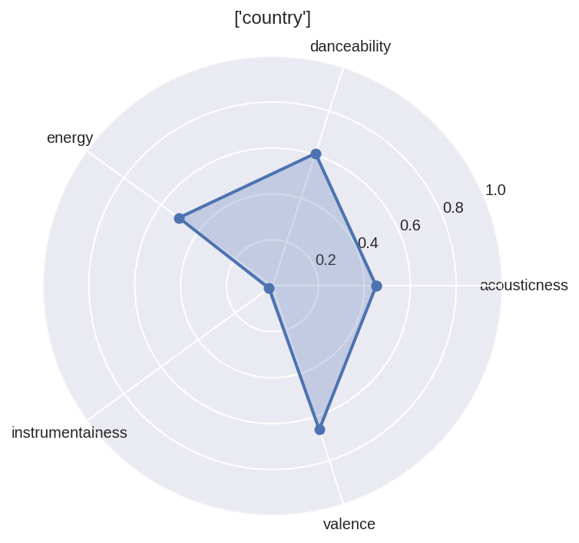
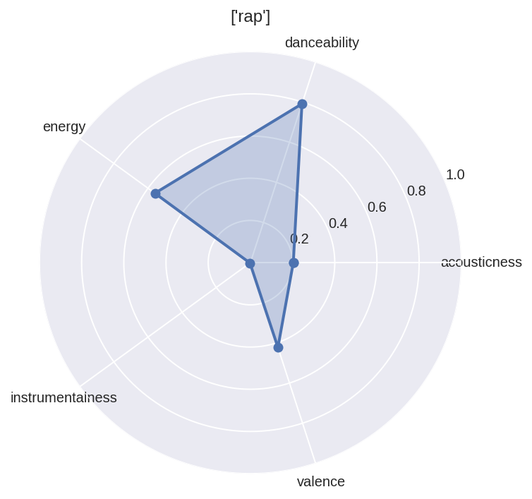
Measuring Genres on Song Attributes
Country
Rap

Slide 17
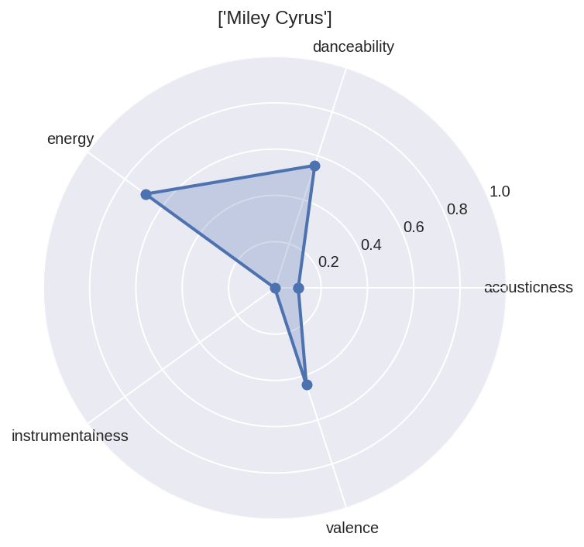
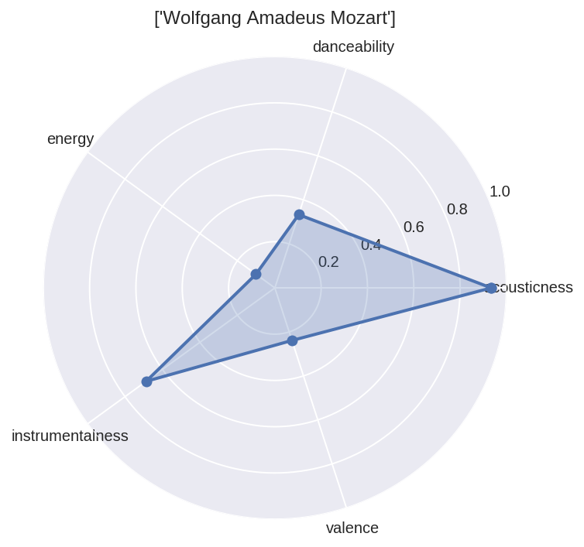
Measuring Artists on Song Attributes
Miley Cyrus
Wolfgang Amadeus Mozart

Slide 18
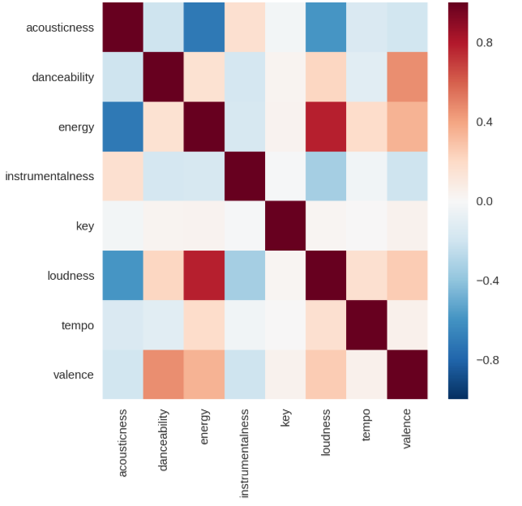
Correlation of Song Metrics

Slide 19
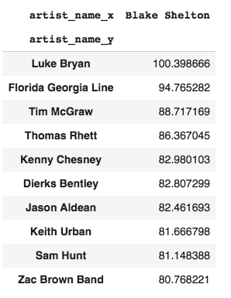
Artist Discovery
An algorithm that recommends other Artists to listen to if you listen to a particular artist
Uses most popular artist combinations within playlists to create “compatibility” score
Ex. For playlists with Blake Shelton, Luke Bryan appears the most, Florida Georgia Line second most, etc.

Slide 20
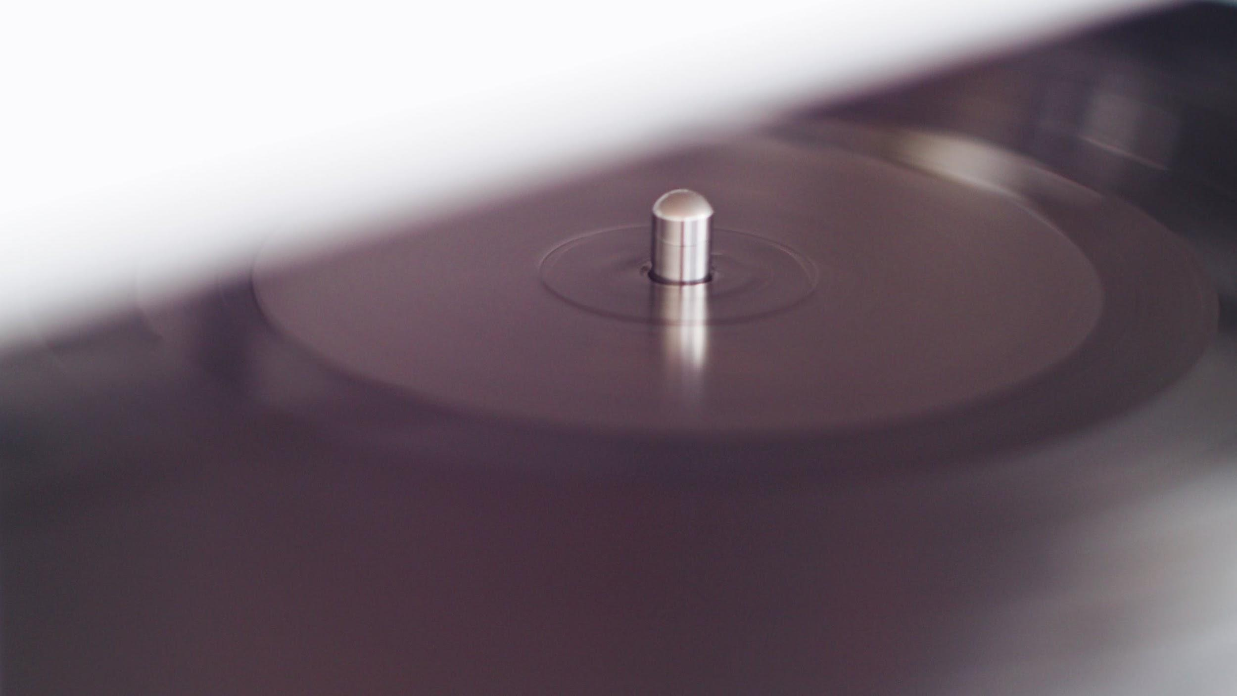

Top Songs by Decade
What are the most popular song from the 80s today? The 90s? 00s?

Slide 21
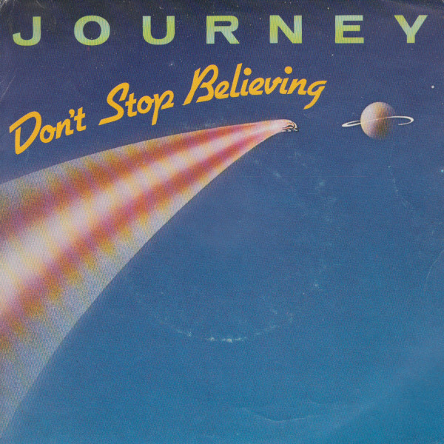
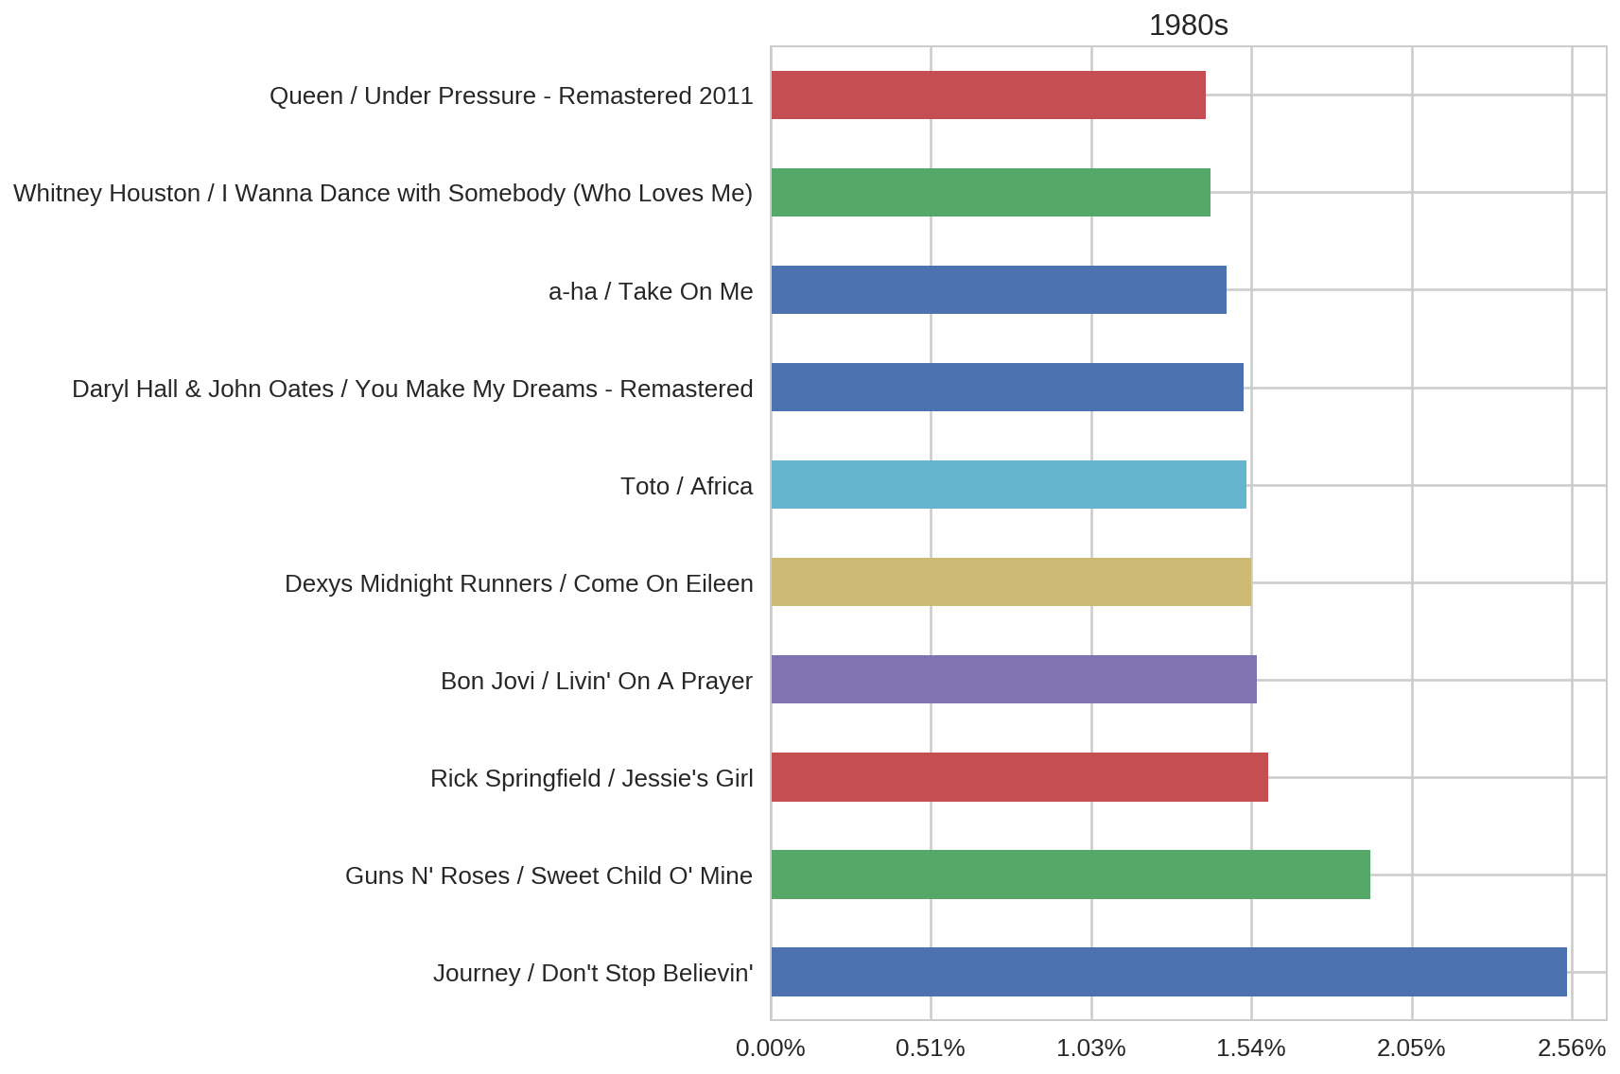
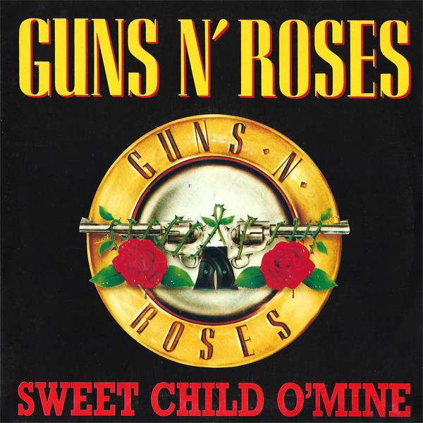
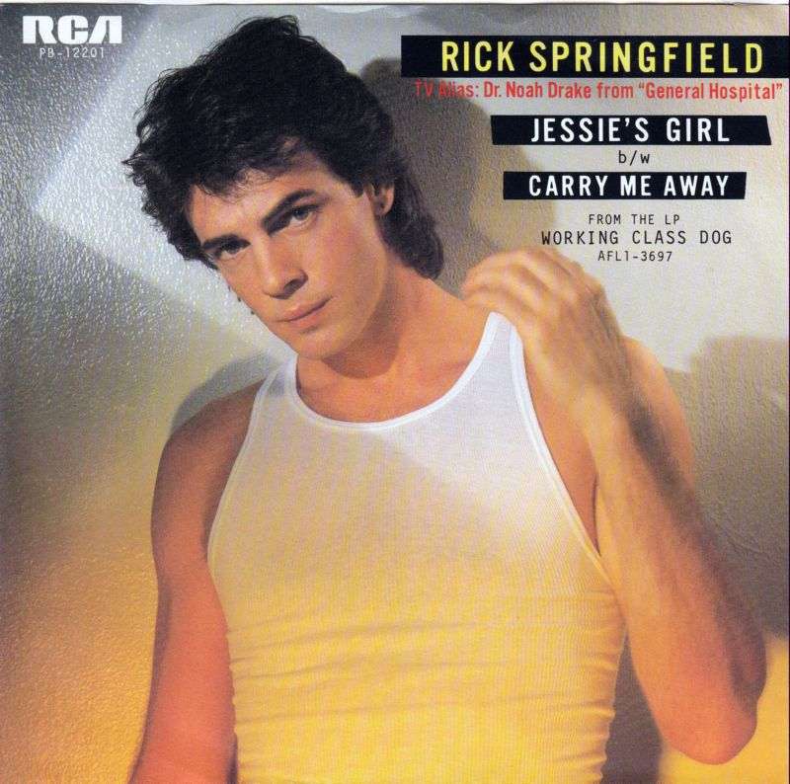
Top Songs from the 80s

Slide 22
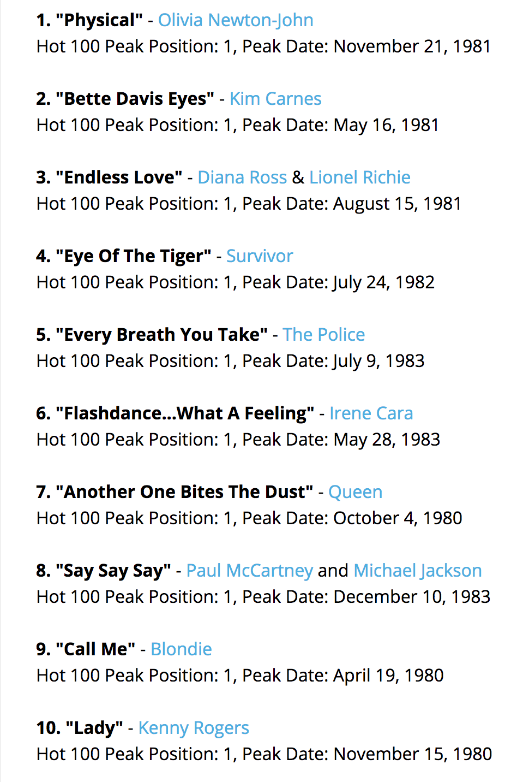
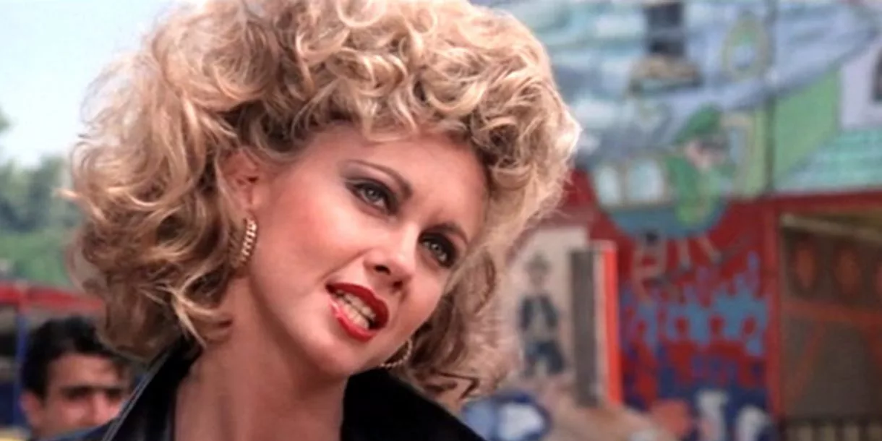
Top Songs from the 80s
Notice anything missing?
https://www.billboard.com/articles/news/6296897/billboard-hot-100-1980

Slide 23
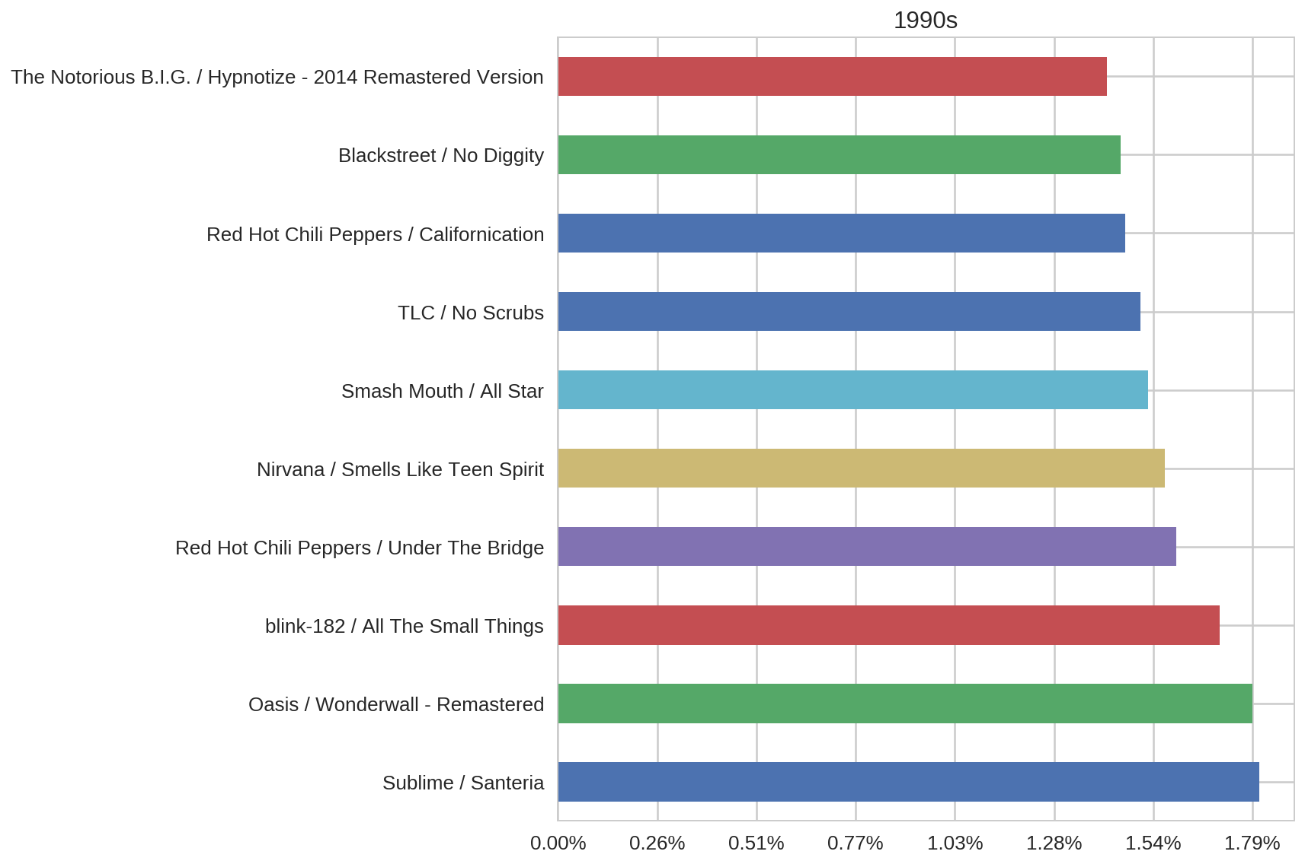
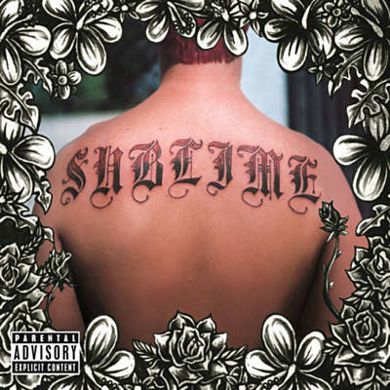
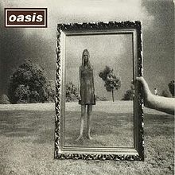
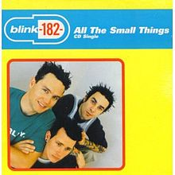
Top Songs from the 90s

Slide 24
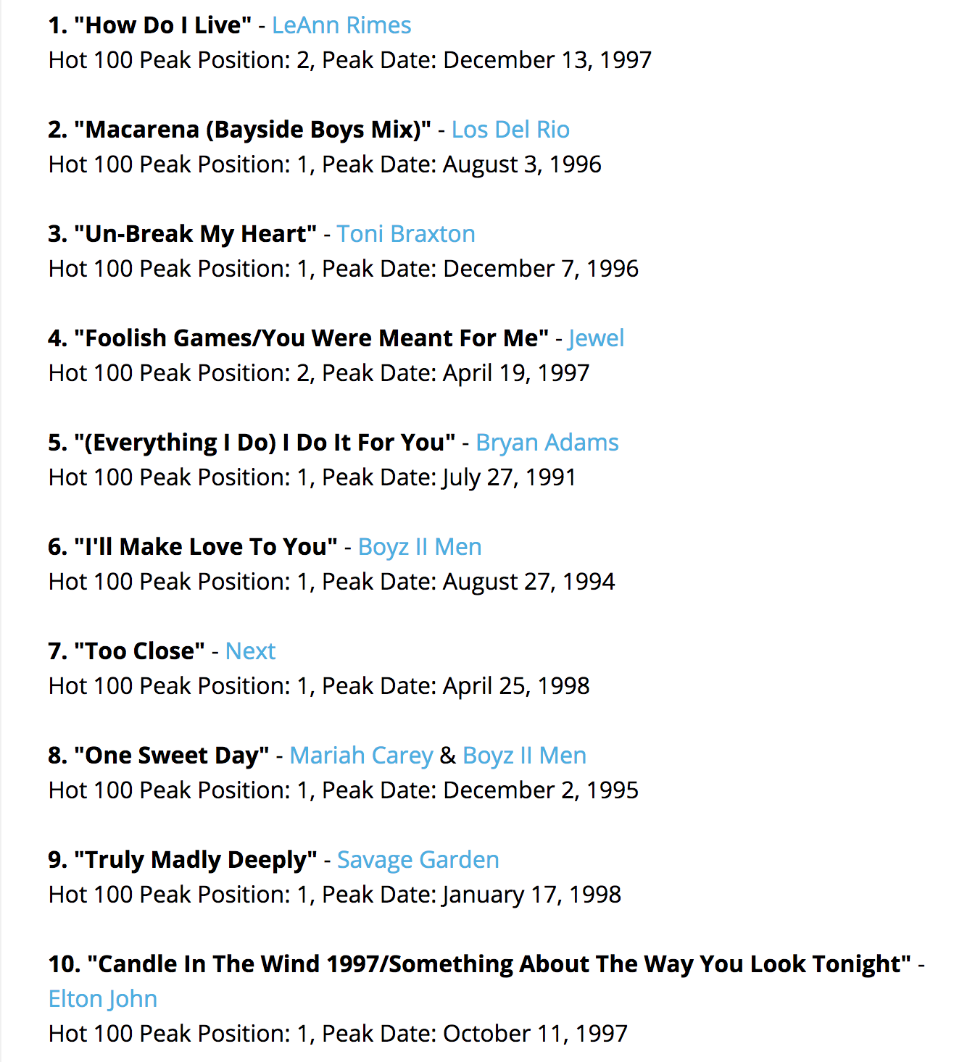
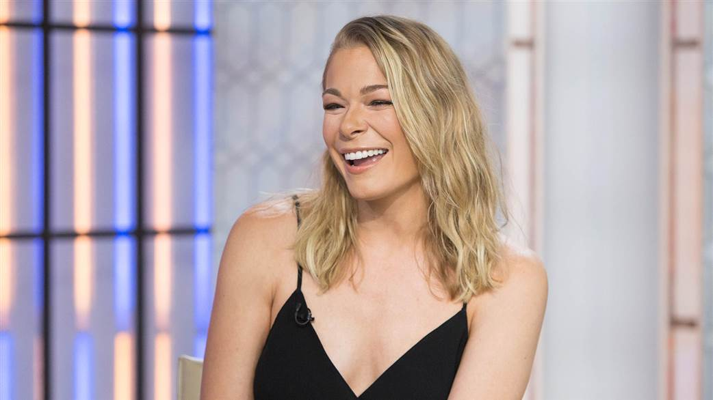
Top Songs from the 90s
Notice anything missing?
https://www.billboard.com/articles/news/6296897/billboard-hot-100-1990

Slide 25
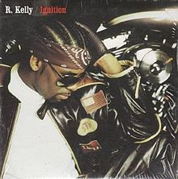
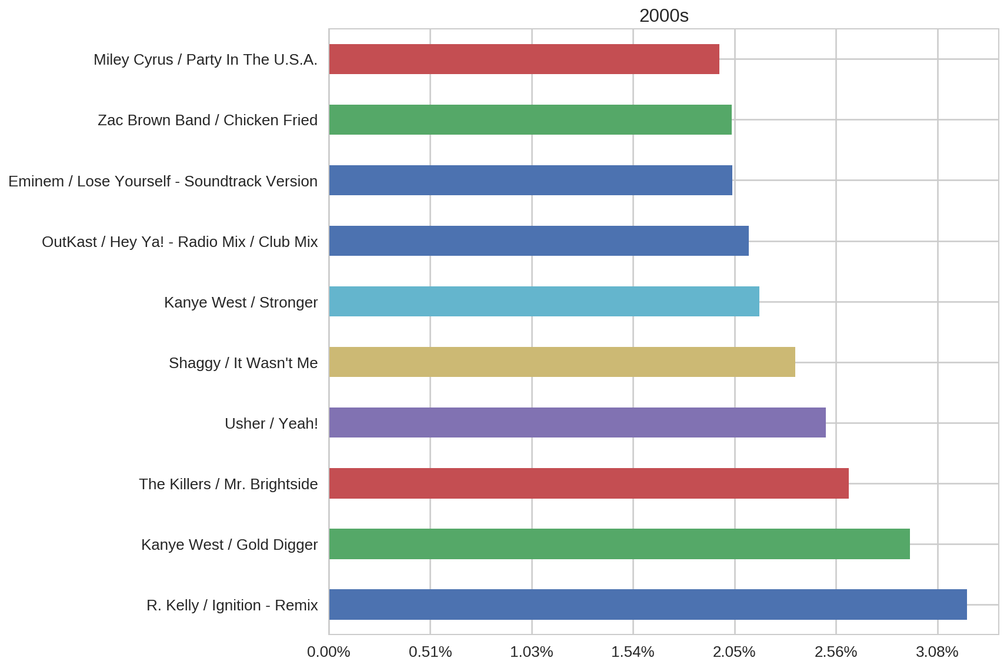
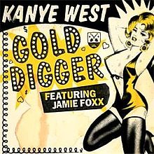

Top Songs from the 2000s

Slide 26
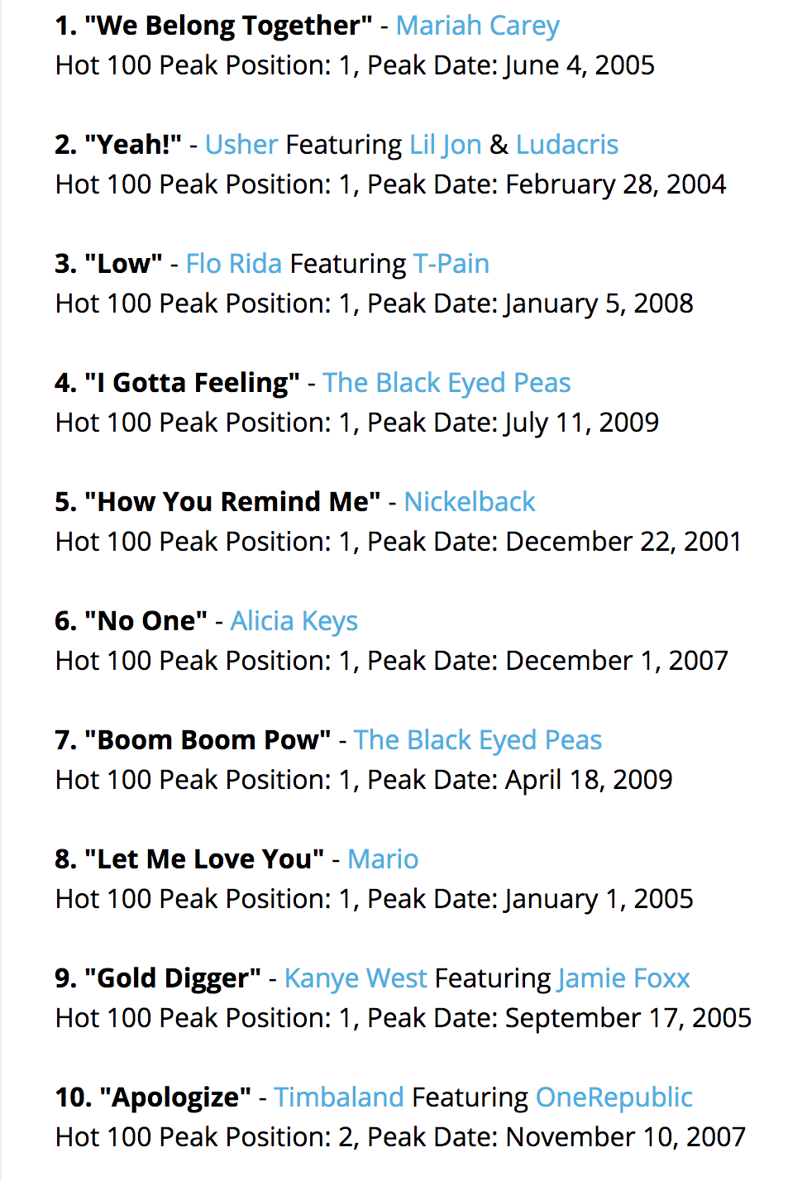
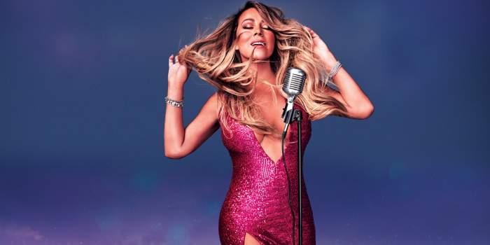
Top Songs from the 2000s
Notice anything missing?
https://www.billboard.com/articles/news/6296897/billboard-hot-100-2000

Slide 27
Conclusion
def dealt_with_data:
print(“Thanks for listening 🎧”)
dealt_with_data()

Slide 28
Appendix
Surprise, Surprise
Predicting If I like a song

Slide 29
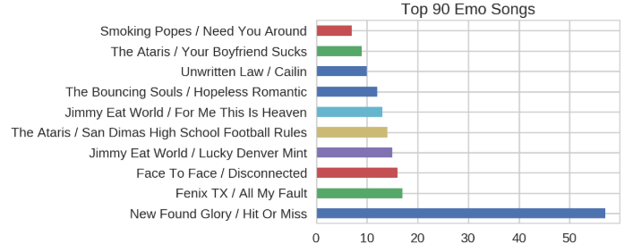
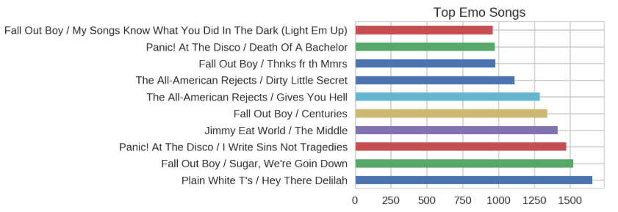
Emo (#ForMP)

Slide 30
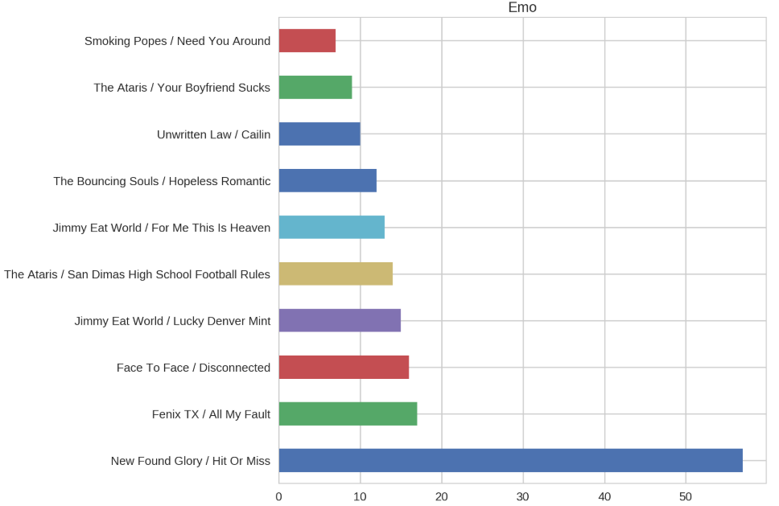
Top 90s Emo
MP’s contribution

Slide 31
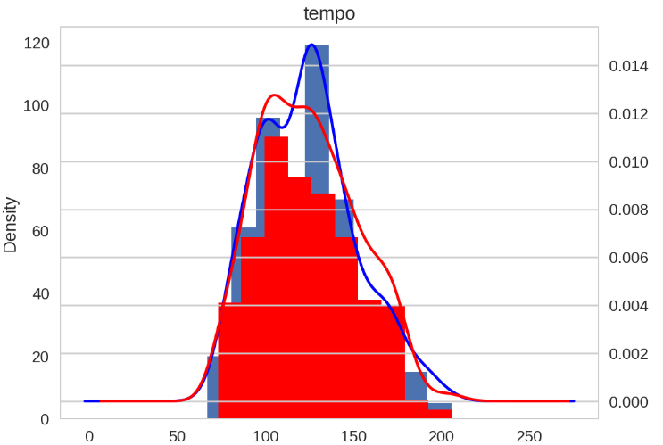
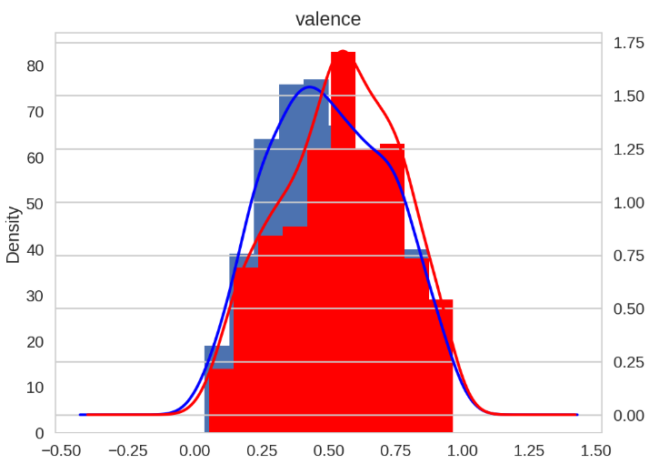
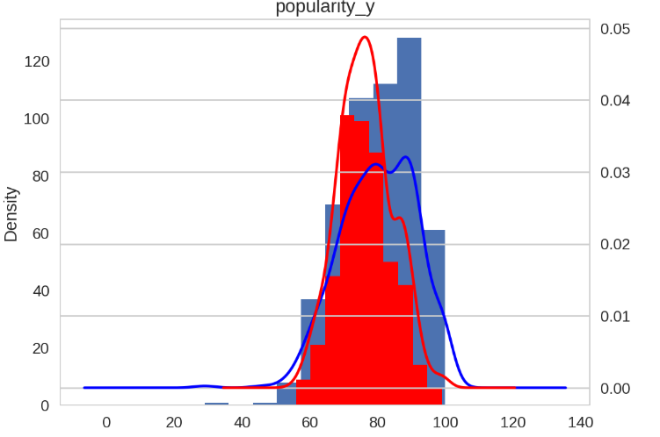
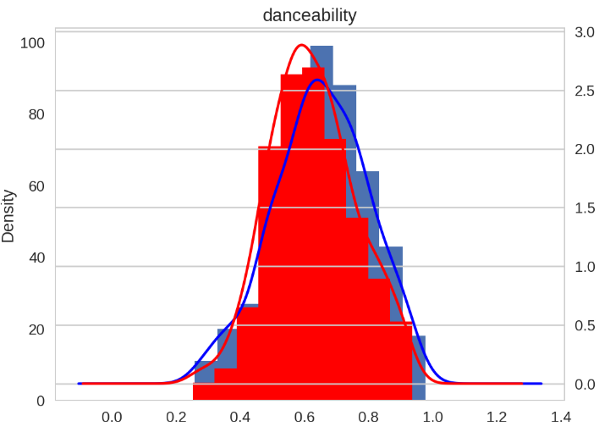
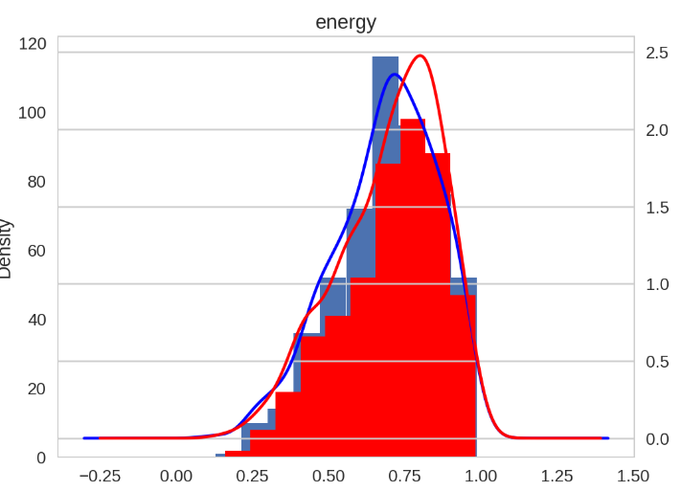

Predicting If I like a song
Red( Songs I Dislike) , Blue( Songs I Like)

Slide 32

Logistic Regression

